Slide 1




DVCS with Positron Beams at the JLab 12 GeV Upgrade
Volker Burkert
Jefferson Lab
Outline:
- JLab Upgrade to 12 GeV, CLAS12
- GPDs & 3D imaging of the nucleon
- DVCS with electrons and positrons
- Estimates of charge-dependent asymmetries
- Summary
Int. Workshop on Positrons at Jefferson Lab

Slide 2







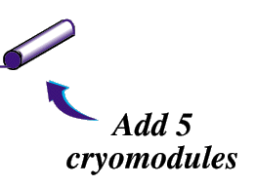
JLab Upgrade to 12 GeV
JLab Upgrade from 6 GeV
Add new hall
CHL-2
Enhance equipment in existing halls
Notes:
A major focus of hadron physics with electromagnetic probes is the determination of new multi-dimensional parton distribution functions in a large kinematics range. This requires experiments at high luminosity and at sufficiently high energy. For this the existing accelerator will be equipped with accelerating superconducting RF cavities with much higher gradients. The additional 5 cryo modules will provide the same energy boost as the 20 existing ones. In addition some of the lower gradient cryo modules will be refurbished

Slide 3
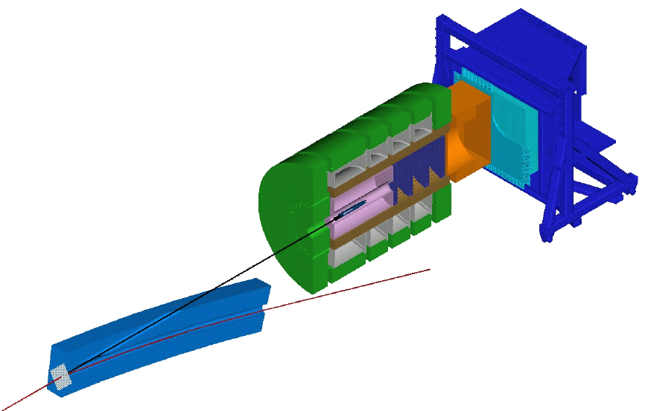
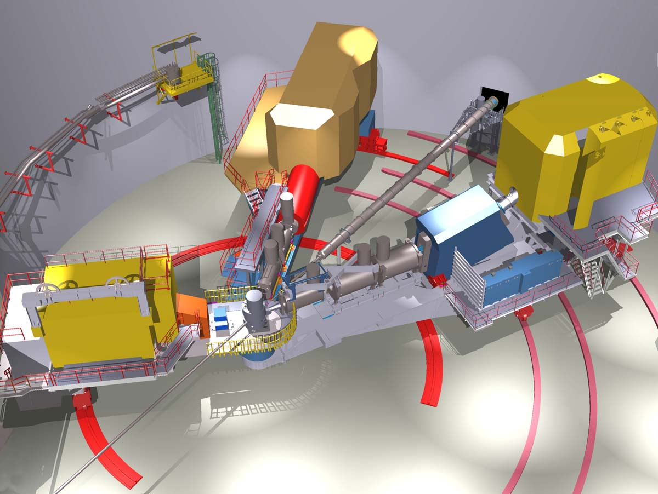
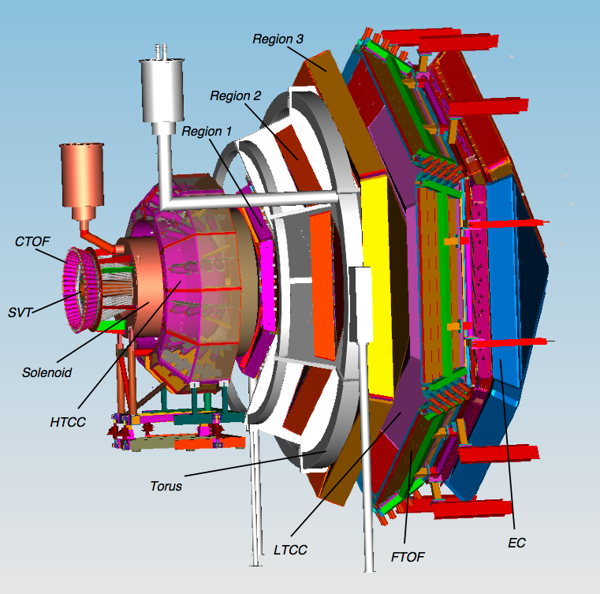

New Capabilities in Halls A, B, & C, and a New Hall D
D
C
9 GeV tagged polarized photons and a 4π hermetic detector
Super High Momentum Spectrometer (SHMS) at high luminosity and forward angles
B
A
High Resolution Spectrometer (HRS) Pair, and specialized large installation experiments
CLAS12 high luminosity, large acceptance.
Notes:
A new Hall will be constructed to house the GlueX detector, that will conduct a search for excited mesons with gluonic components, and the existing Halls will be upgraded with new equipment as well. Hall C will have an additional super high momentum spectrometer. Hall A will retain the existing spectrometers and provide space for new specialized equipment to address a variety of physics topics. Hall B will house the CLAS12 detector which is the focus of this of workshop. At 12 GeV JLab will be ideal for precision studies at large Bjorken x.

Slide 4
CLAS12
CLAS12
Central
Detector
Forward
Detector
GPDs & TMDs
Nucleon Spin Structure
N* Form Factors
Baryon Spectroscopy
Hadron Formation
2m

Slide 5
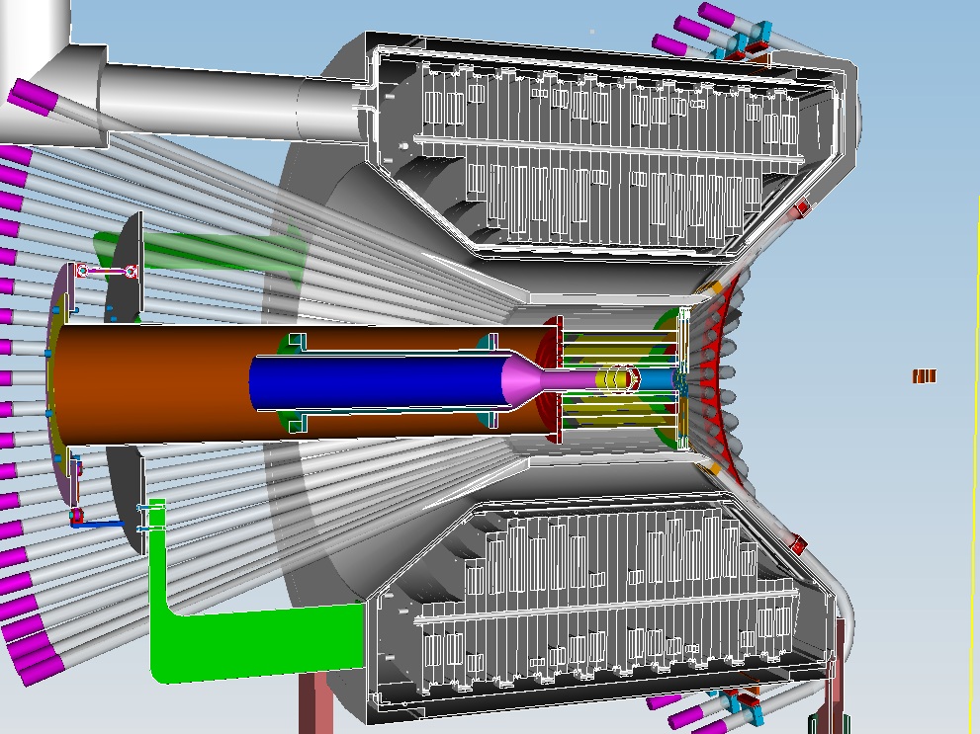
CLAS12 – Central Detector SVT, CTOF
Charged particle
tracking in 5T field
ΔT < 60psec in for
particle id
Moller electron shield
Polarized target
operation ΔB/B<10⁻⁴

Slide 6
CLAS12 – Design Parameters
Forward Central
Detector Detector
Angular range
Tracks 5⁰ – 40⁰ 35⁰ – 125⁰
Photons 2.5⁰ – 40⁰ ---
Resolution
δp/p (%) < 1 @ 5 GeV/c < 5 @ 1.5 GeV/c
δθ (mr) < 1 < 10 - 20
Δφ (mr) < 3 < 5
Photon detection
Energy (MeV) >150 ---
δθ (mr) 4 @ 1 GeV ---
Neutron detection
N_{eff} < 0.7 (EC+PCAL) under development
Particle ID
e/π Full range ---
π/p < 5 GeV/c < 1.25 GeV/c
π/K < 2.5 GeV/c < 0.65 GeV/c
K/p < 4 GeV/c < 1.0 GeV/c
π⁰→γγ Full range ---
η→γγ Full range ---
L=10³⁵cm⁻²s⁻¹

Slide 7
Initial Science Program
CLAS12
Physics Focus | Approved experiments | LOIs supported
GPD’s & exclusive Processes | 3 | 1
TMDs & SIDIS | 4 | 4
Parton Distribution Function & DIS | 2 | 1
Elastic & resonance form factors | 2
Hadronization & Color Transparency | 2
Baryon Spectroscopy |  | 1
Total | 13 | 7
Approved experiments correspond to about 5 years of scheduled beam operation .

Slide 8

3D Nucleon Structure Frontier
3-D Scotty
2-D Scotty
b_{y}
b_{y}
b_{x}
x
x
1-D Scotty
Deeply Virtual Processes. GPDs & TMDs
Water
probablity
Calcium
Deep Inelastic Scattering & Forward Parton Distribution Functions.
Carbon
x
Notes:
Much of the science program is about the 3D imaging of the nucleon. The nucleon is here represented by a living being. We can make 2D slices of Scotty and may see something like this. Of course, Scotty would no longer be able to function as a living being. In a 1-dimensional projection Scotty would lose all its resemblance with the original, and we may just be able to characterize the chemical composition (or flavor) as a function of x. However, we would not know where in transverse space the molecules are distributed and how they are held together.
Yet , this analogy is not so far from how we have studied the proton’s composition in the past. The PDFs measured in deep inclusive scattering represent a one-dimensional projection of the real proton possibly with a flavor tag on it, i.e. u-quark or d-quark distribution function. To restore the 2-and 3-dimenional representation we need to measure processes that are sensitive to the GPDs and TMDs, i.e. deeply exclusive and semi-inclusive processes.

Slide 9
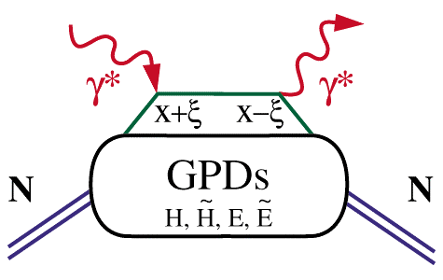
Access to GPDs - Handbag Mechanism
GPDs depend on 3 variables, e.g. E(x, ξ, t). They probe
the quark structure at the amplitude level.
Deeply Virtual Compton Scattering (DVCS)
x
hard vertices
x – longitudinal quark
momentum fraction
γ
2ξ – longitudinal
momentum transfer
x+ξ
x-ξ
ξ
x_{B}
=
2-x_{B}
–t – Fourier conjugate
to transverse impact
parameter
t
What is the physical content of GPDs?
Notes:
The basic process in accessing the proton structure through exclusive processes is the “handbag” mechanism. Here shown for the DVCS process.
The important aspects is that we have hard scattering vertices here and here and the soft part is described by the GPDs. The upper and lower part factorize which allow us to probe GPDs in hard scattering processes with photons. There are 4 GPDs which depend on 3 kinematics quantities: the quark longitudinal momentum fraction x, the longitudinal momentum transfer to the quark xi and the 4-momentum transfer to the proton. What is the physical content of the GPDs ?

Slide 10
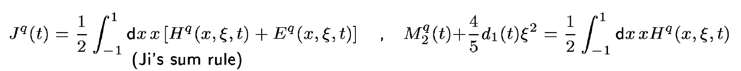
Physical content of GPD E & H
Nucleon matrix element of the Energy-Momentum Tensor of QCD contains three scalar form factors (R. Pagels, 1965) and can be written as (X. Ji, 1997):
M₂(t) : Mass distribution inside the nucleon
J (t) : Angular momentum distribution
d₁(t) : Forces and pressure distribution
Directly measured in elastic graviton-proton scattering.
GPDs are related to these form factors through 2nd moments
t=0: Ji’s Angular Momentum Sum Rule
To determine J(t) we need to measure the x and t dependence of GPDs.
To separate M₂(t) and d₁(t) we need measurements at small and large ξ(x_{B}).
Notes:
The nucleon matrix element of the energy-momentum tensor is known to contain 3 form factors (R. Pagels, 1965). For a long time they were of little interest as the only known process where they could be directly measured is elastic scattering of gravitons off the nucleon. However, these form factors appear as moments of the unpolarized GPDs as shown here. The quark angular momentum in the nucleon is given by the 2nd moment of the sum of GPD H and E. The mass and pressure distribution of the quarks are given by the 2nd moment of H where the pressure is probed by parameter xi.

Slide 11
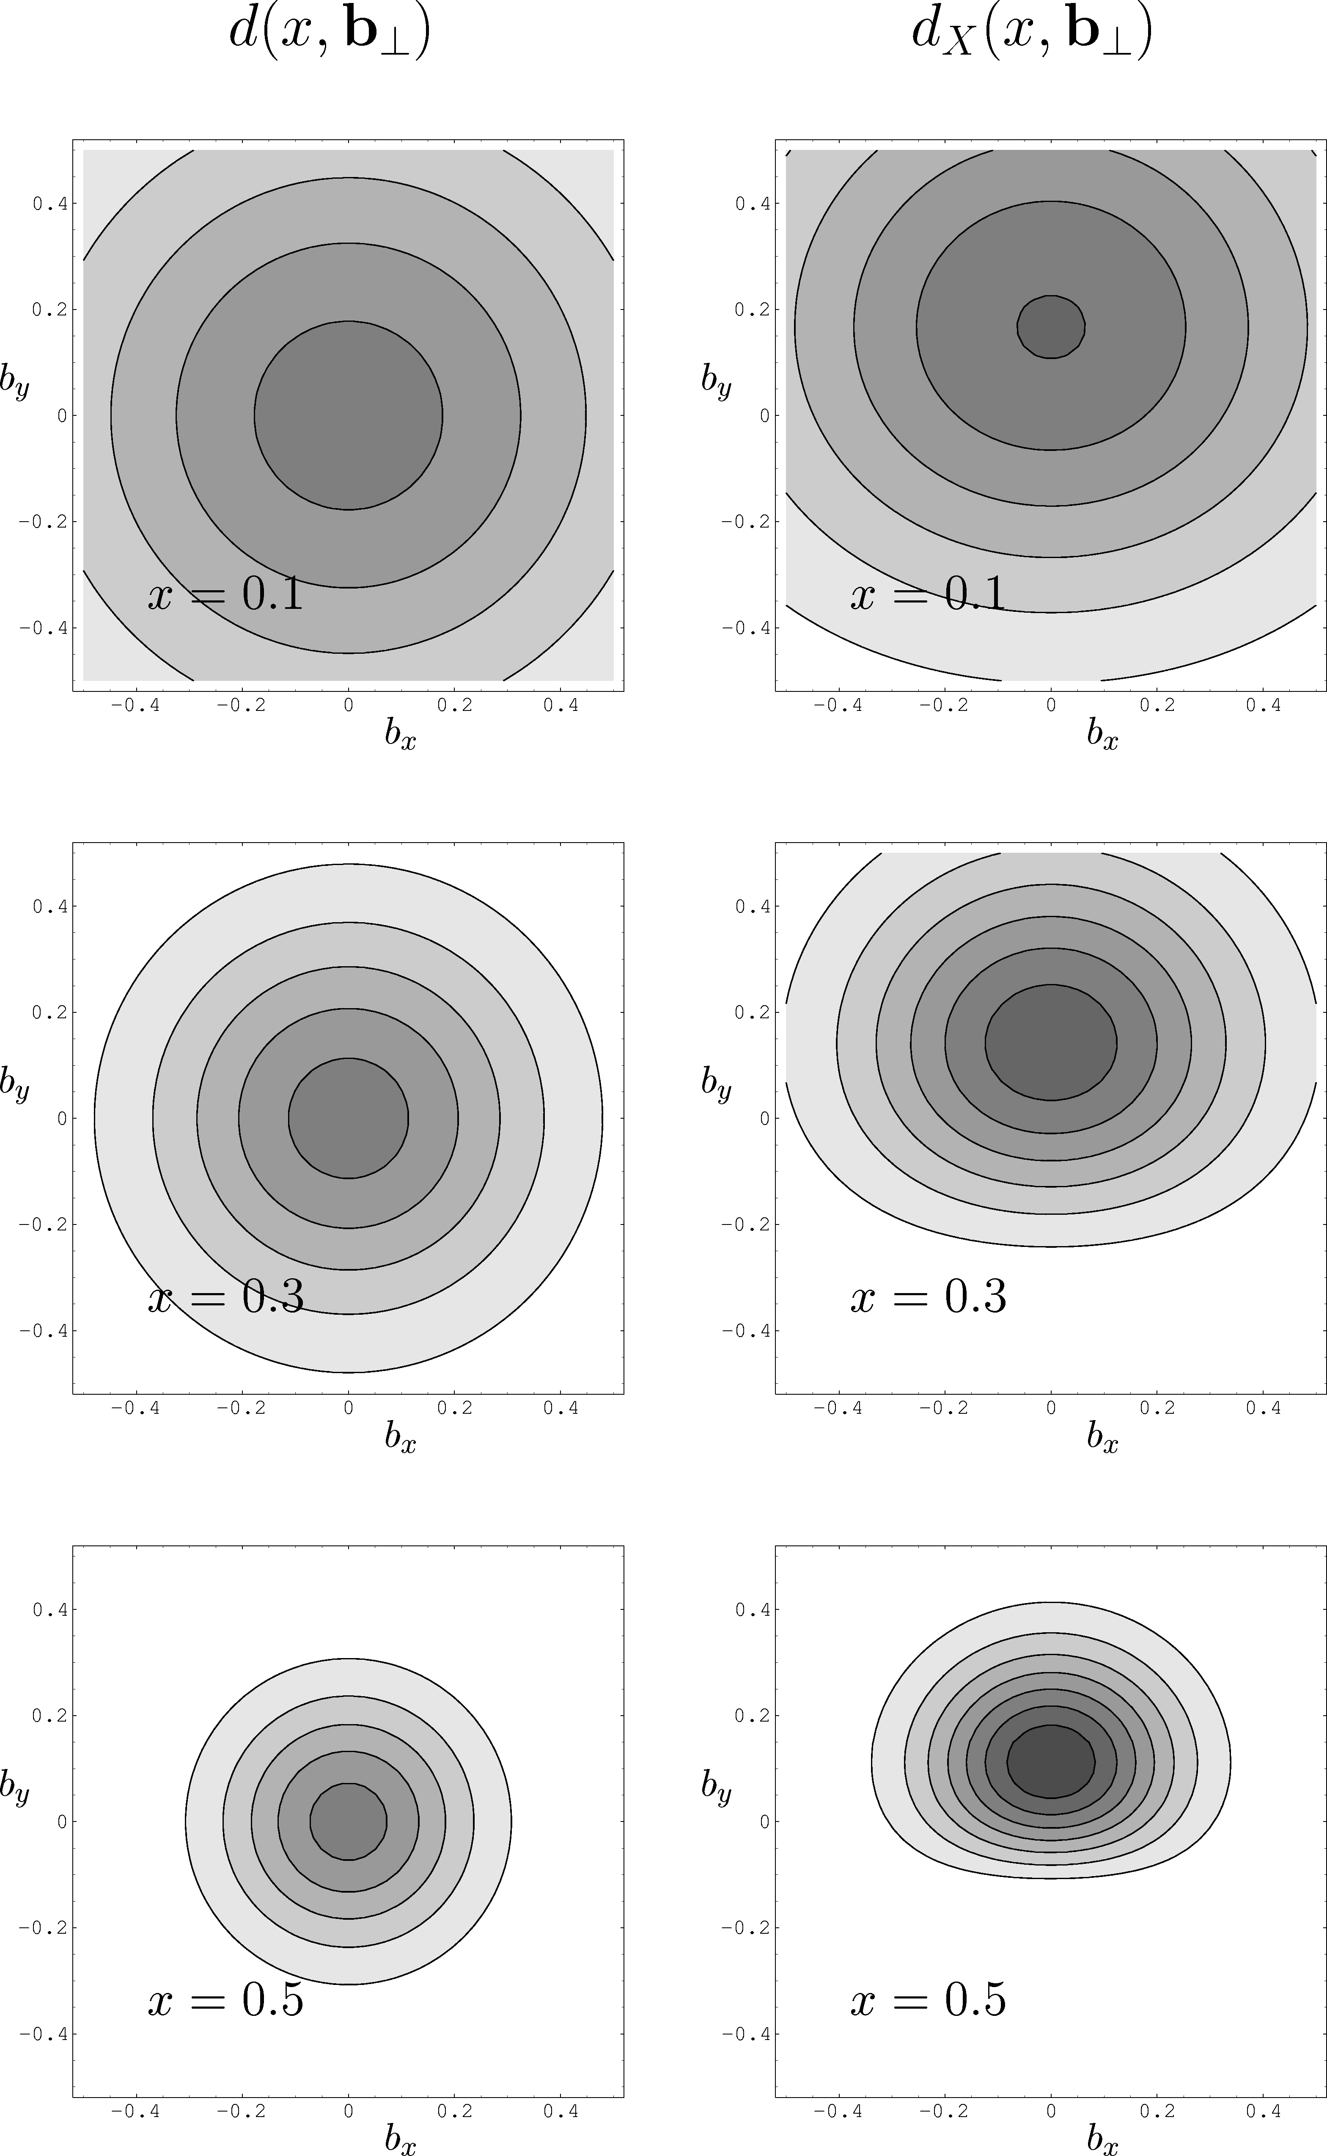
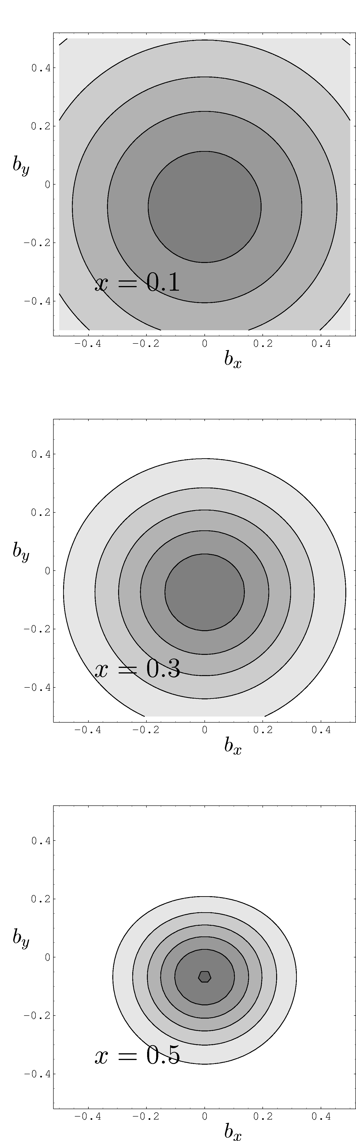
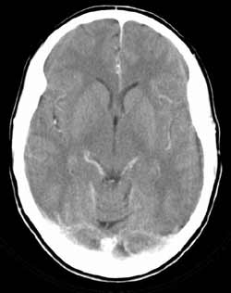
The Promise of GPDs:
2-D & 3-D Images of the Proton
Target polarization
∫
d²Δ
ε(x,b ) =
T
e^{iΔ b} E_{q}(x,Δ )
T
(2π)²
T
T
d_{X}(x,b )
u_{X}(x,b )
T
T
T
M. Burkardt
Cat scan of the
human brain
Flavor dipole
Shift depends on ε(x,b )
T
Notes:
11
Knowing GPDs we can construct slices of the proton similar to cat scans of the human brain. A Fourier transformation of GPD H & E to impact parameter space gives 2D slices of the transverse quark distributions at fixed momentum fraction x and measures she shift of the center of gravity of up and down quarks for a transversely polarized proton.

Slide 12
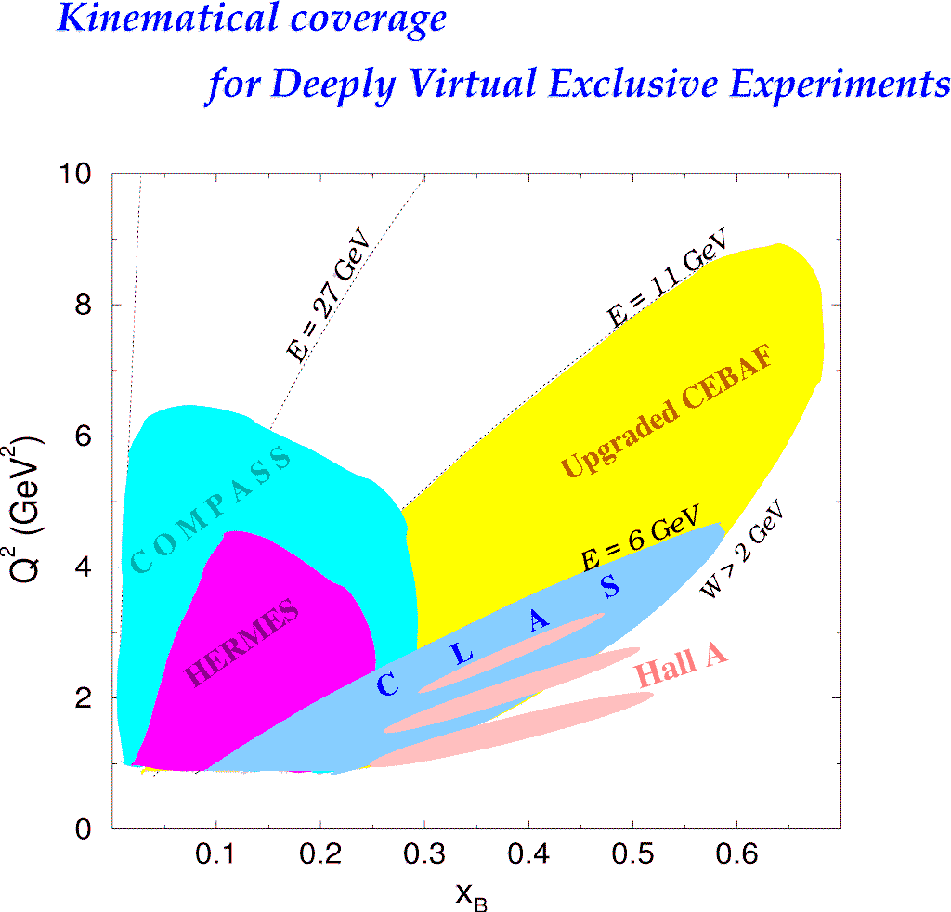
Deeply Virtual Exclusive Processes -
Kinematics Coverage of the 12 GeV Upgrade
H1, ZEUS
H1, ZEUS
27 GeV
200 GeV
JLab Upgrade
JLab @ 12 GeV
COMPASS
W = 2 GeV
HERMES
Study of high x_{B} domain requires high luminosity
0.7
Notes:
The kinematics range that can be covered in exclusive processes with high precision data is shown with this yellow area. This will be the only accelerator where the valence quark regime can be fully covered with high precision data.

Slide 13
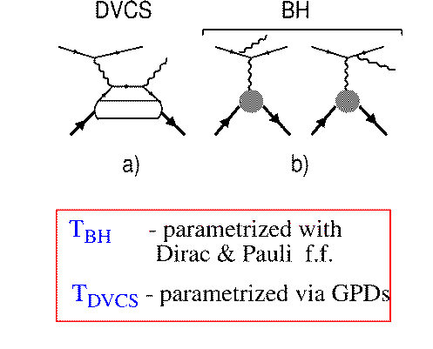
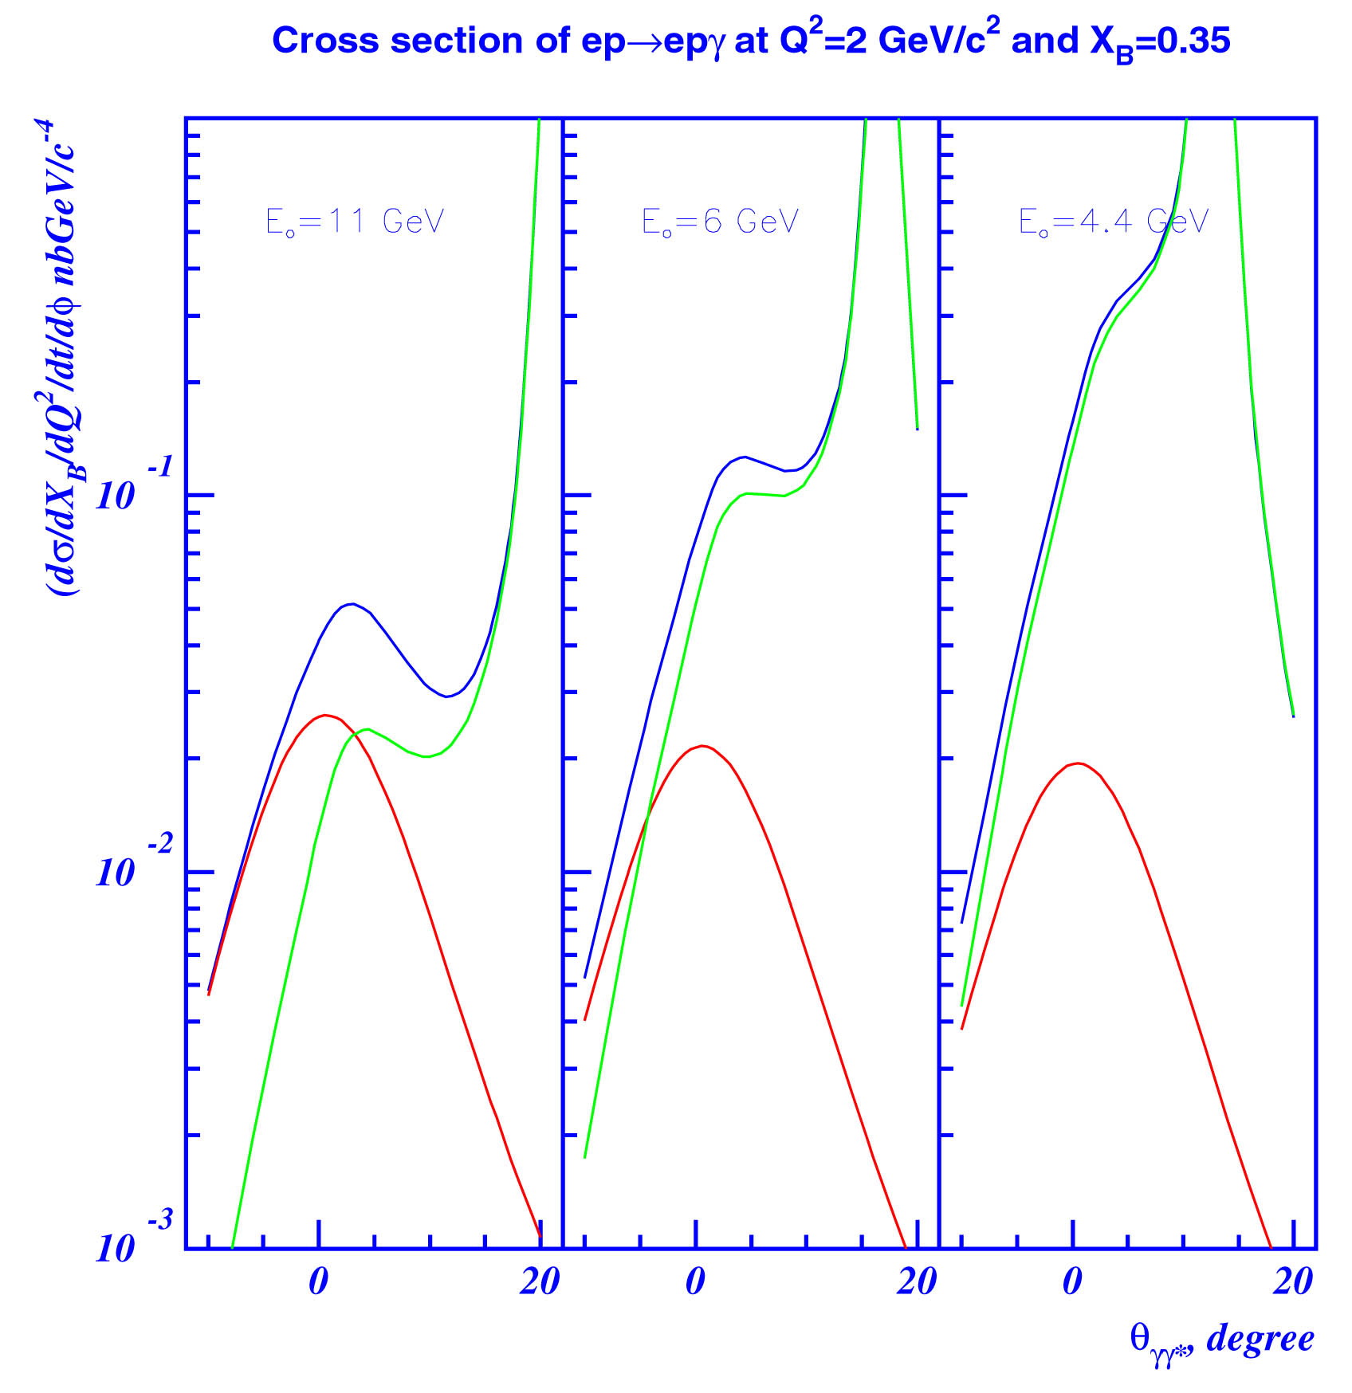
Accessing GPDs through DVCS
DVCS
e
e
BH
E_{o} = 11 GeV
E_{o}= 6 GeV
E_{o}= 4 GeV
p
p
d⁴σ
~ |A^{DVCS} + A^{BH}|²
dQ²dx_{B}dtdφ
BH
A^{BH :} given by elastic form factors F₁, F₂
A^{DVCS}: determined by GPDs
DVCS
I ~ 2(A^{BH})Im(A^{DVCS})
BH-DVCS interference generates spin-dependent and charge-dependent cross section differences => use spin-polarized electrons/positrons and polarized targets.
Notes:
DVCS is not the only process generating high energy photons. At lower energies and for specific kinematics the cross section is dominated by photons emitted from the electron line, the well known Bethe-Heitler process. The cross section is given by sum of the two amplitudes squared, where the BH contribution only depends on the two elastic form factors and is real, while the DVCS contribution is given by the unknown GPDs and has an imaginary part. The relative importance of the two processes is very much dependent on the beam energy and on the scattering angle as shown in these graphs. DVCS photons are emitted mostly along the direction of the virtual photon while the Bethe-Heitler process dominates at very small angles relative to the incoming electron. With increasing beam energy, the two processes are increasingly separated in kinematics as can also be seen in these graphs. While at small energies BH is expected to dominate in nearly the entire kinematics, at high energies DVCS becomes dominant. If we can isolate the interference part we access GPDs directly. This is possible by using spin polarized electron beam or spin polarized targets.

Slide 14
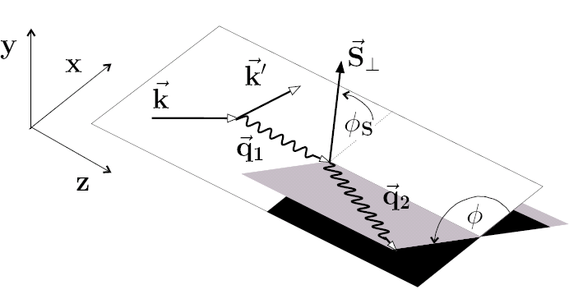
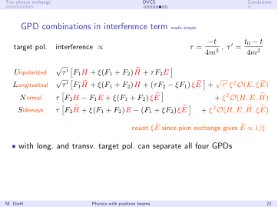
GPD combination in interference term
Target
polarization
Interference term ~
τ=-t/4M²
With longitudinal and transverse target polarization we can separate all 4 GPDs

Slide 15
CLAS
DVCS/BH Beam Spin Asymmetry
Large kinematics coverage
Fully integrated asymmetry and
one of 65 bins in Q², x=ξ, t.
Fit: A_{LU} = αsinφ/(1 + βcosφ)

Slide 16
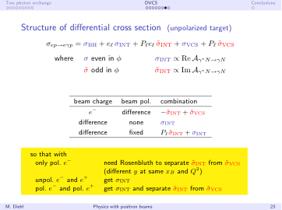
Structure of differential cross section
Polarized Beam, unpolarized Target:
M. Diehl, Genoa, 2009
e⁺
e⁺

Slide 17
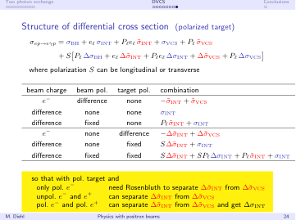
Structure of differential cross section
Polarized Target:
M. Diehl, Genoa, 2009
e⁺
e⁺

Slide 18
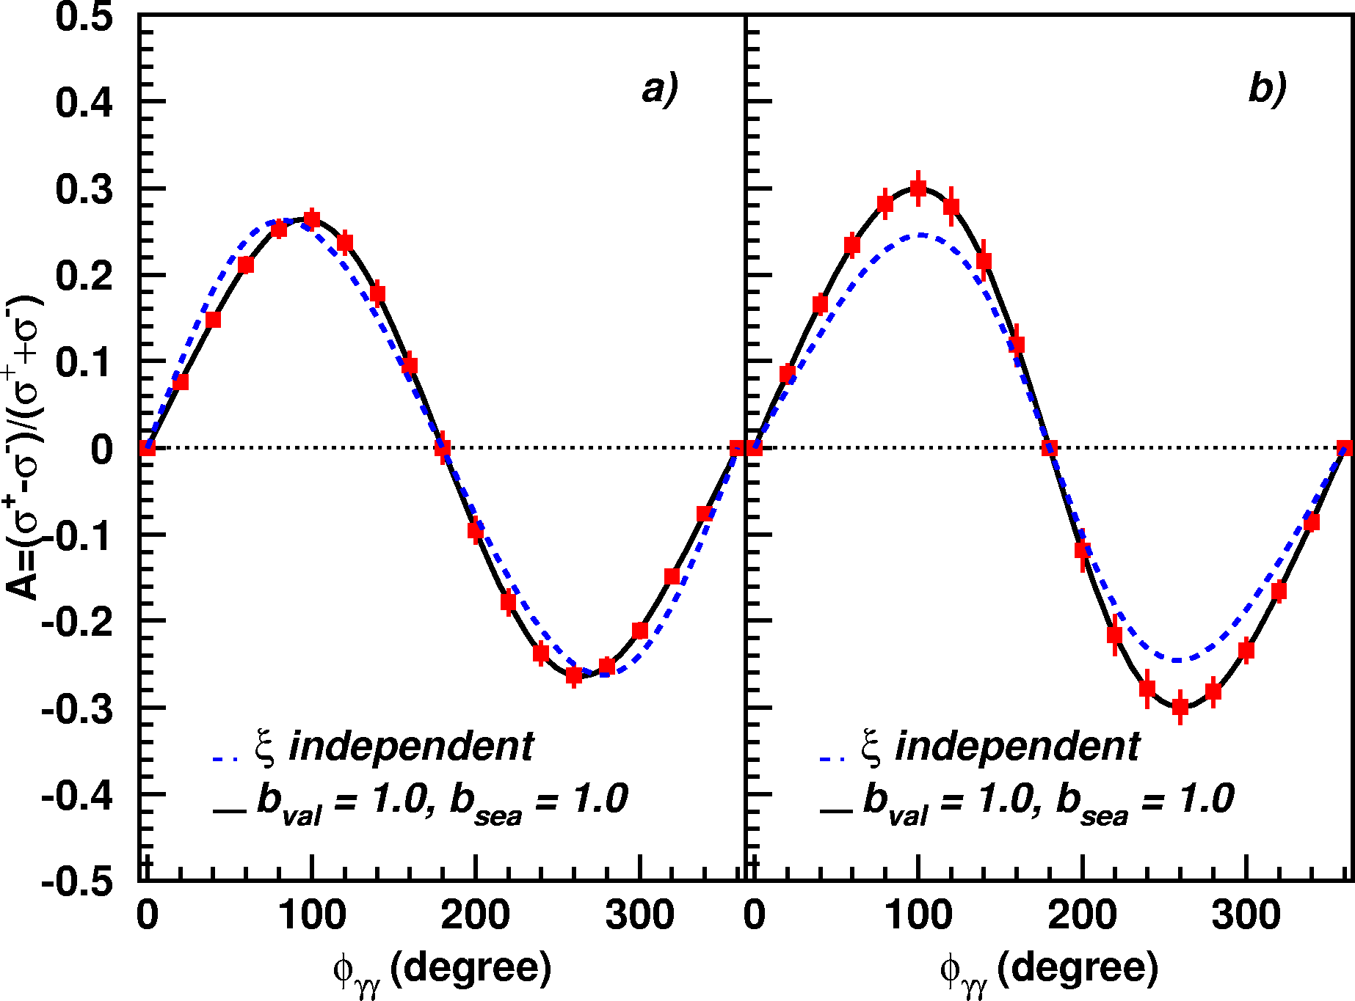
CLAS12 - DVCS/BH- Beam Asymmetry
E_{e} = 11 GeV
Q²=5.5GeV²
x_{B} = 0.35
-t = 0.25 GeV²
0.3
0.2
0.1
0
-0.1
-0.2
-0.3
Notes:
This shows the statistical accuracy expected for one of these interference patterns.

Slide 19
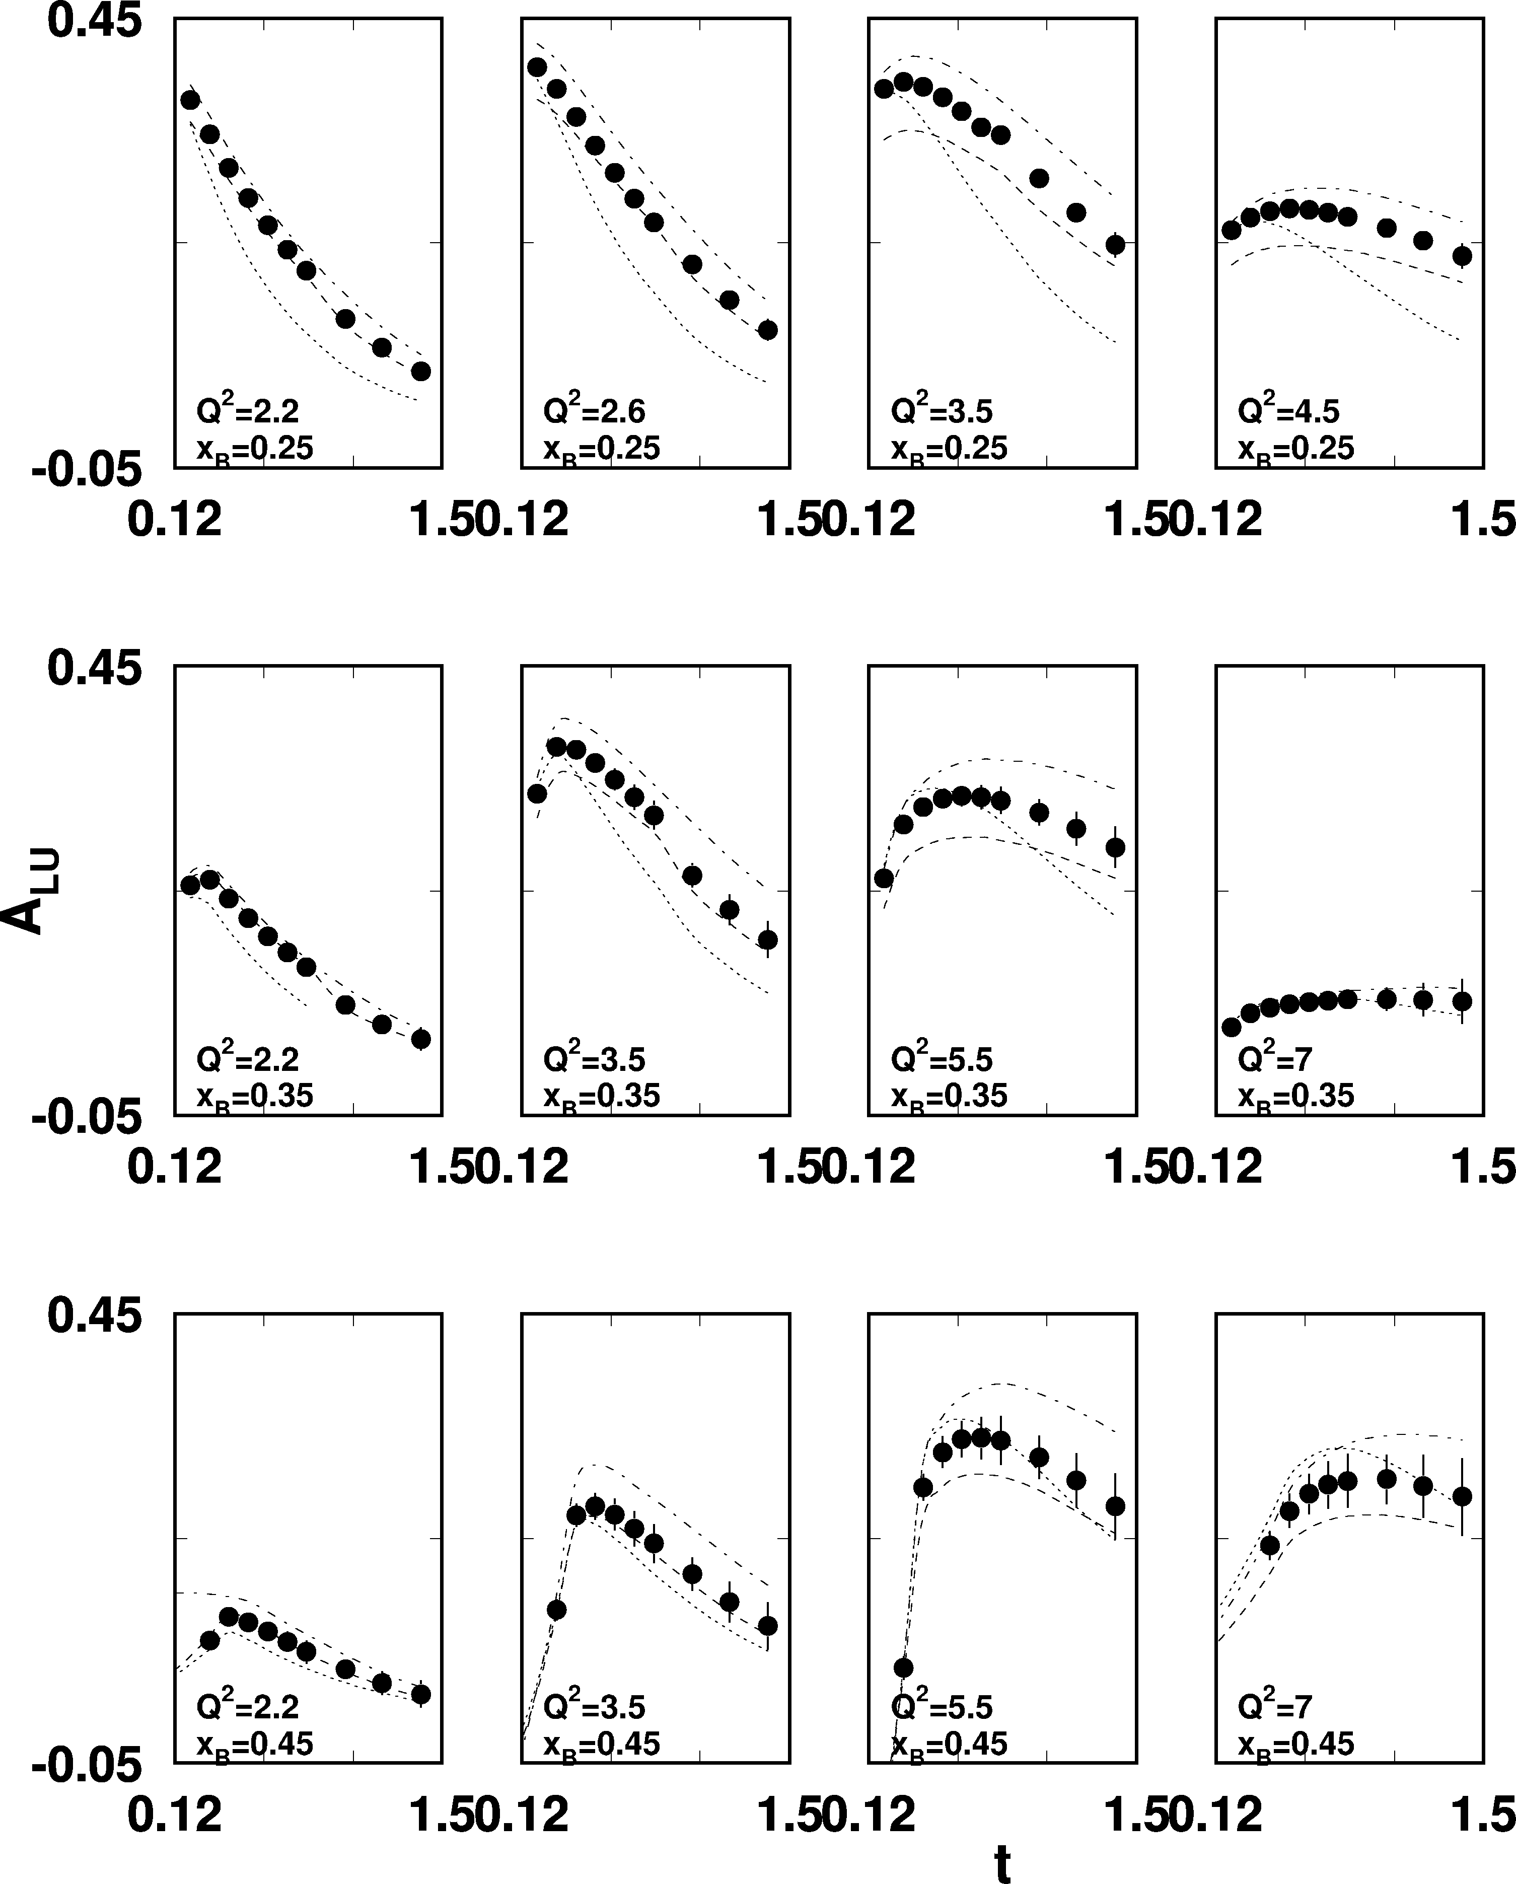
A path towards the extraction of GPDs
e p epγ
σ⁺ − σ⁻
σ⁺ + σ⁻
Δσ
2σ
A =
=
Δσ_{LU}~sinφ{F₁H+..}dφ
Kinematically
suppressed
Sensitive to H(ξ,t)
Notes:
The leading sin-phi term for each one of the azimuthal interference patters turns into one data point for the t-dependence at different x and Q2.

Slide 20
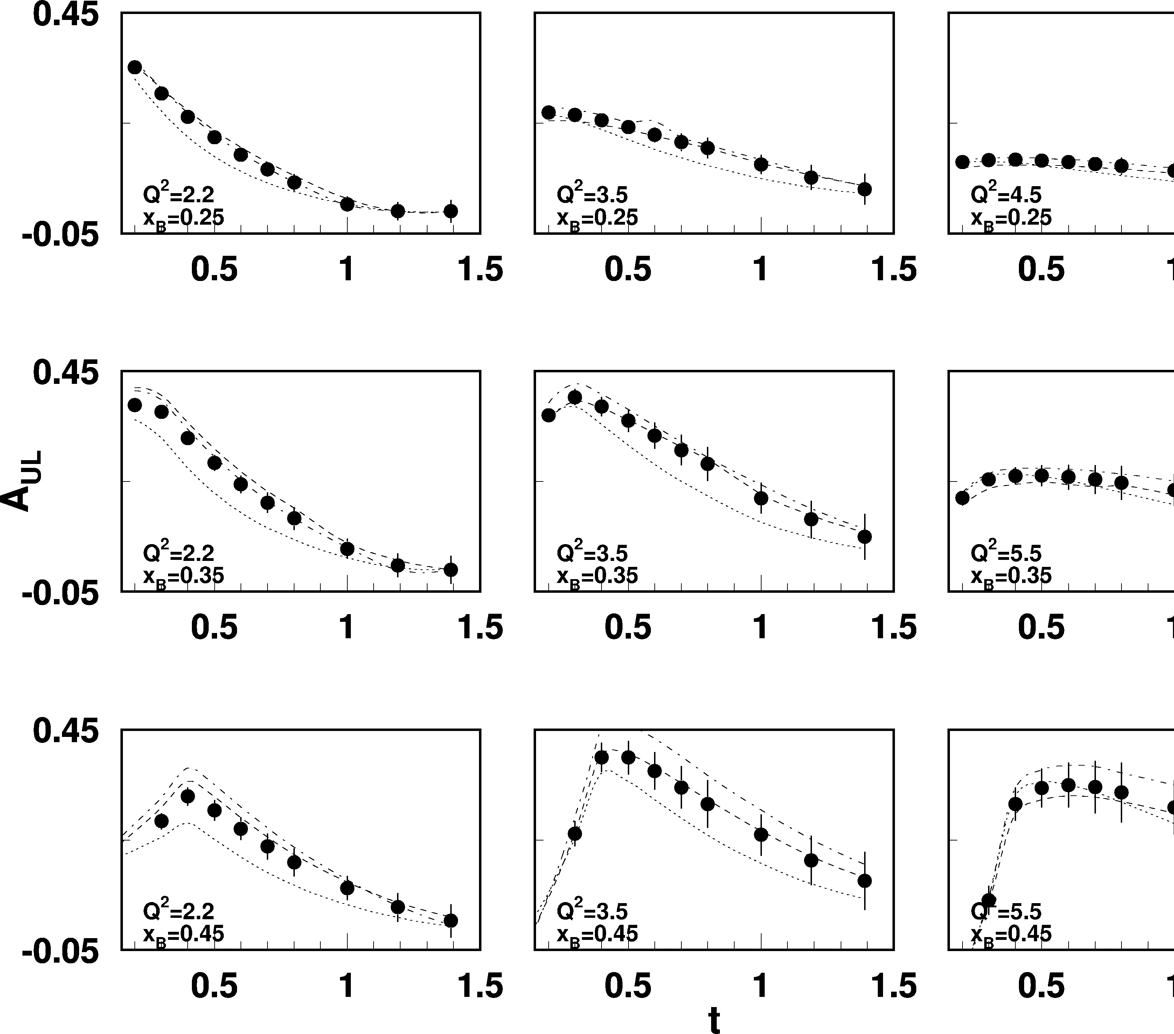
DVCS/BH Longitudinal Target Asymmetry
e p epγ
Longitudinally polarized
target
~
Δσ_{UL}~sinφIm{F₁H+ξ(F₁+F₂)H...}dφ
~
Sensitive to H(ξ,t)
Notes:
Similar data can be obtained with a longitudinally polarized targets.

Slide 21
DVCS/BH Target Asymmetry
e p epγ
Sample kinematics
Q²=2.6 GeV², x_{B} = 0.25
Transverse polarized target
Δσ_{UT} ~ sin(φ−φ_{s})cosφIm{k₁(F₂H–F₁E)+…} dφ
Sensitive to E(ξ,t)
Notes:
And for completeness the asymmetry for transverse polarized targets. The asymmetries are highly sensitive to the u-qurak contributions to the proton spin.

Slide 22
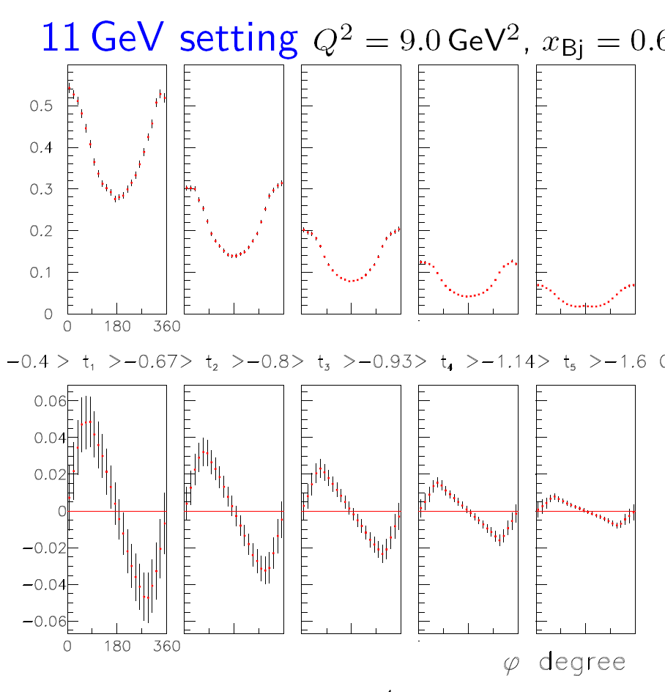
Hall A - DVCS Projections
Use 3 beam energies: 6.6, 8.8, 11.0 GeV
Helicity-independent cross sections
Helicity-dependent cross sections

Slide 23
Model calculations and simulated data
Model calculations: V. Guzey (2009)
Dual parameterization of GPDs, includes GPDs H & E only.
Statistical error estimates (H. Avakian):
Acceptance: Detection of full final state epγ in CLAS12
Electrons: 1000 hrs at L=10³⁵cm⁻²s⁻¹
Positrons: 1000 hrs at L=2x10³⁴cm⁻²s⁻¹ , 8nA (10 cm lH2)
Beam quaiity
- σ_{x}, σ_{y} < 2mm
- energy spread σ_{E}/E < 0.003
Other issue:
- Positron polarimetry at 12 GeV?

Slide 24
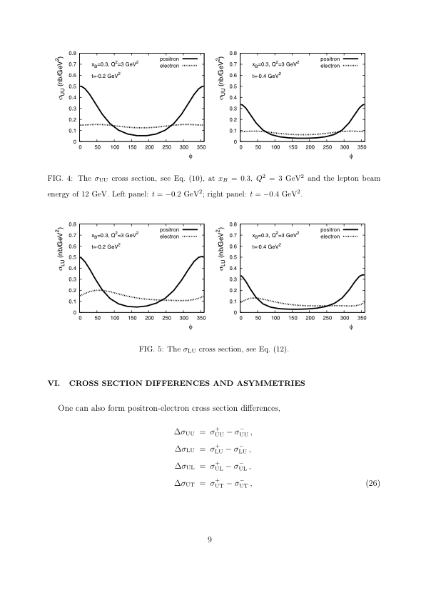
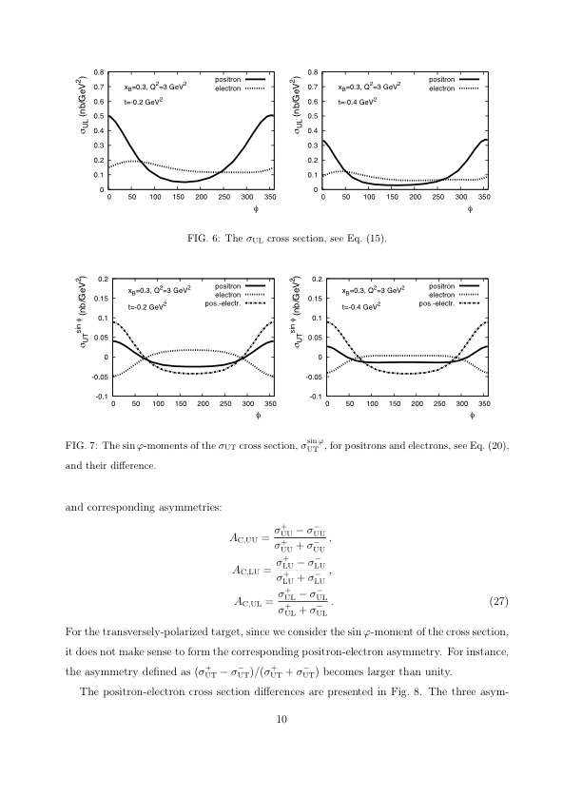
Cross sections for electron & positron beams
V. Guzey, 2009

Slide 25
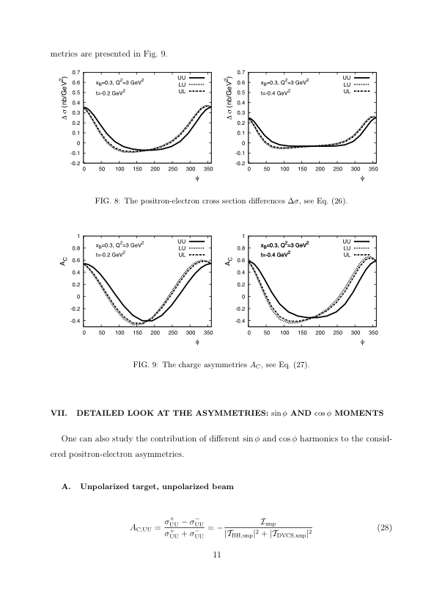
Charge asymmetries
V. Guzey, 2009
Significant differences for σ_{UU} / σ_{LU}
Differences σ_{LU} and σ_{UL} small –
model only includes GPD E, H

Slide 26
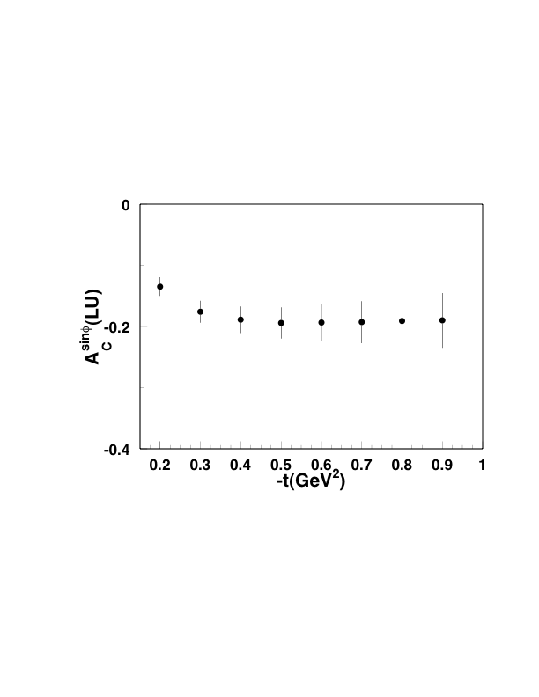
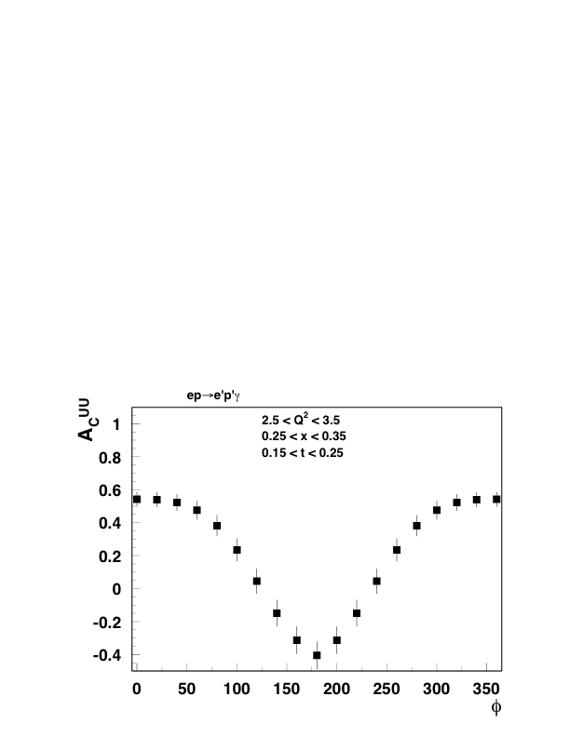
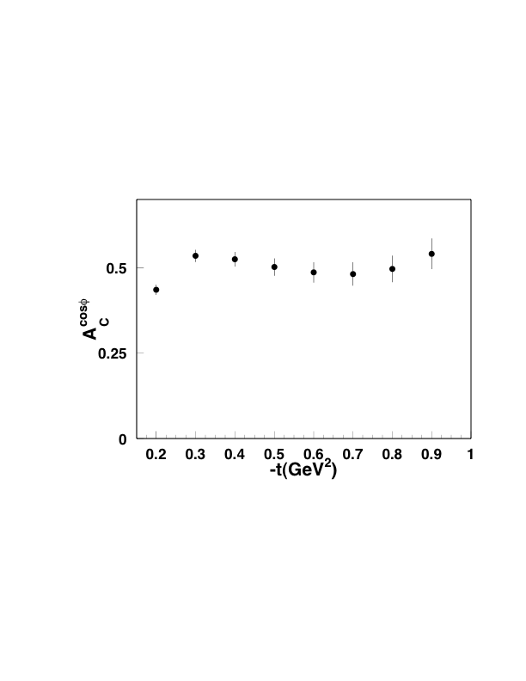
Projected Charge Asymmetries – Target unpolarized
V. Guzey, 2009
0.5

Slide 27
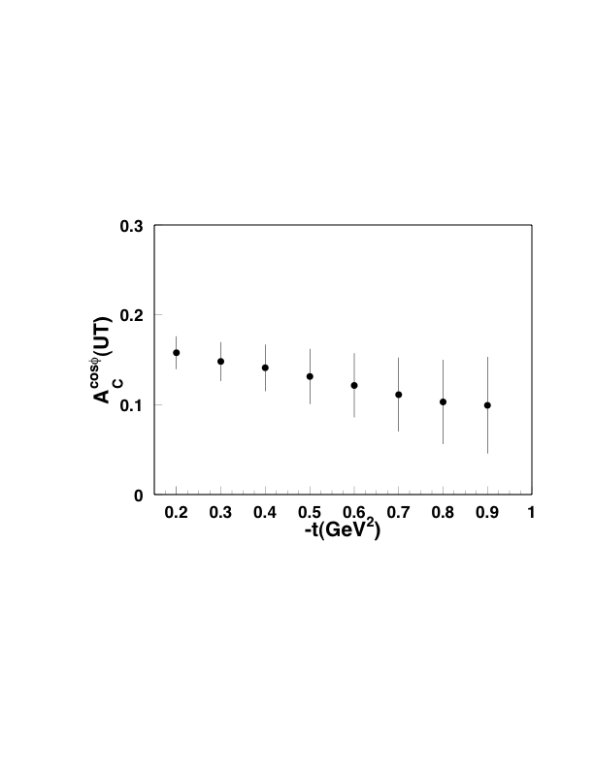
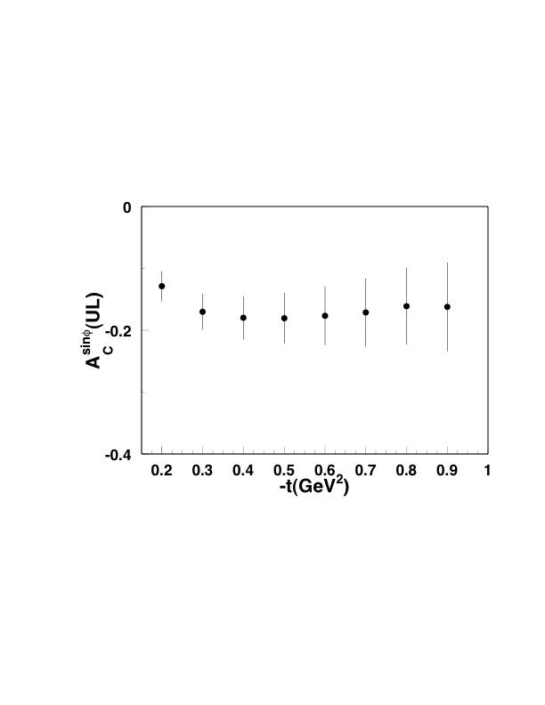
Projected Charge Asymmetries – Target polarized

Slide 28
Summary/Conclusions
DVCS is a crucial part of the JLab physics program at 12 GeV
It provides cleanest access to the GPDs and is the basis for the 3D imaging of the nucleon.
Polarized electron beams on unpolarized and polarized proton and neutron targets allow access to various combinations of GPDs in the measured cross sections
Positron beams of the same energy as electrons will significantly enhance the GPD program by allowing the separation of different combination of GPDs in the charge dependent terms of the cross section.
Polarized positrons will allow to make the maximum out of the DVCS program.
A positron current of 8nA is required for a minimal program with CLAS12, a current of 20-40nA would be ideal.
Physics with positrons in other Halls requires currents > 1 μA.
Notes:
This graph shows the beam asymmetry integrated over Q2 and xB and t. The physics lies in the various kinematical dependencies. The right graphs shows the events broken up into Q2 and xB bins, still integrated over t. We see that for the low x_b and higher Q2 the asymmetry is dominated by sin-phi. Significant deviations are observed only at high x_{B} and low Q². The inset shows one of 65 bins in Q2, x_B, t.

